Slide 1
Beaumanor Residential Visit Information for pupils
Notes:
Plan to share information with pupils on Tuesday 3 May
Taken pupils here on many occasions

Slide 2
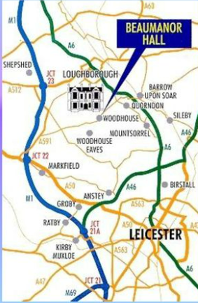
We’re off to Beaumanor next week but there’s a few things you need to know.
On the way in, you should have been given a copy of a booklet that gives you lots of information about what we are getting up to. Please share this information with your parents.

Slide 3
Staffing and Communication
Night
Miss Molloy
Mrs McDermott
Mrs Bassett / Miss Garner
Miss Fletcher
Mr Perham
Mr Knight
Miss Winton
Mrs Patel is hoping to visit on Monday evening and Dr Murphy on Tuesday evening.
Day
Miss Molloy
Mrs McDermott
Mrs Bassett
Miss Garner
Mrs Pancholi
Mrs Saddington
Mrs Taylor
Mr Knight
Miss Winton

Slide 4
Safety
Other people will be at Beaumanor Hall but they will not be sharing rooms or bathrooms with you.
Girls and boys are in separate dormitories.
Pupils are fully responsible for their own belongings.
No electronic devices are permitted.
You will wear a wristband with Miss Winton’s number on it.
Notes:
Phones for those on buses – phones can be brought but they must be switched off at all times, any pupil using a phone will be sent home.

Slide 5
Behaviour expectations
Pupils are expected to:
Continue to uphold all usual school rules.
Follow instructions given quickly to make the most of the experience.
Treat everyone kindly so that happy memories are made for all.
Remember that they are representatives of the school and all that entails.
Any pupil who cannot do these things will work through a sanctions system of warnings and time out. There is a risk that they may need to be sent home if they cannot do the above.

Slide 6
Kit List
Please ensure that the bag is one that you can lift / carry and that you can repack it.
Toiletries (toothbrush, toothpaste, shampoo, body wash, no aerosols please)
Towels x2 (Hand towel, bath towel)
Sun cream
Nightwear
Underwear including socks (x4)
Indoor shoes
Tops i.e. t-shirt/long sleeve top/ jumper x3
Bottoms i.e. tracksuit/jeans/leggings x 3
Shorts x 2
Sweatshirt / fleece
Waterproof jacket
Sun hat
Old trainers
Plastic bag for any wet kit
Medication/inhalers (To be named and handed to staff)
Books / Notepad / Small games
Refillable water bottle
Torch
A pillow
A sleeping bag
Notes:
Day pupils – always bring a change of clothes, on canoeing day, will also need a towel.
Keep things tidy
Talk through why each of these will be useful

Slide 7
Groups
Group
1 | 2 | 3 | 4 | 5 | 6
Miss Molloy | Mrs Bassett | Miss Garner | Mrs McDermott | Mrs Taylor | Mrs Pancholi
Freddie A Max Lewis Rashmi Gracie Freddie H Laura S George Meriel Josh AW Josh | Roshan Arjun O Diana Emelia Florence Seb Noah Zahra Patrick Eric H Mila | Arjun S Felicity Greeta Alia Lilly Peter Eric L Zac Sia Finlay Angelina | Alfie Luc Martha Macie Louis Lola Sophia Rosie Elias Jacob Szofika | James B William Emmy Emily Izzy Alexa Olivia Beatrice Lexi Elodie Laura H | Aksel Ava Gwen Iris Scarlett Grace Hadley Millie James W Henry Alex
11 | 11 | 11 | 11 | 11 | 11

Slide 8
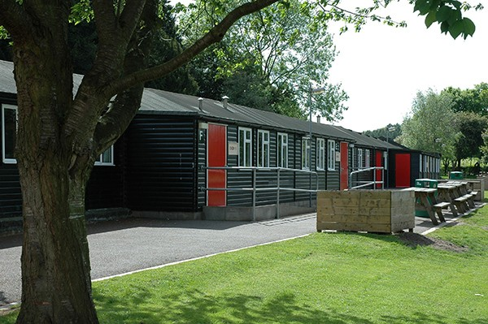
Dorms
Cabin 1 | Cabin 2 | Cabin 3 |  | Cabin 4
Roshan Alex Noah Eric H Patrick Henry Aksel James W James B Peter William Eric L Zac Finlay Arjun S | Josh A Freddie A Max Lewis Luc Freddie H Louis Jacob George Alfie Josh W | Scarlett Florence Ava Iris Diana Emelia Gwen Hadley Grace Millie Zahra Felicity Alia Greeta Sia Lilly Angelina |  | Izzy Beatrice Rashmi Gracie Alexa Martha Lexi Macie Lola Rosie Sophia Laura S Olivia Szofika Meriel Elodie Emmy Laura H
Mrs Bassett / Miss Garner Miss Fletcher | Mr Perham / Mr Knight | Miss Winton |  | Mrs McDermott / Miss Molloy
Notes:
Each cabin will have at least one adult sleeping in it – you will know who this is and where they are sleeping.
If your name is not on the list, that is because you are coming for the day only.
Bunk beds – can decide when you get there
We do not expect you to be in the rooms during the day to play unless the weather is absolutely rubbish.
You cannot go into someone else’s cabin without permission from an adult.
When it is time to sleep, you sleep.

Slide 9
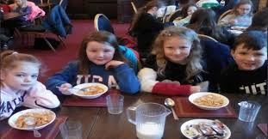
Food
First meal you have there will be lunch.
Dinner
Supper
Breakfast
If you bring snacks, please keep them sealed. You won’t need lots.

Slide 10
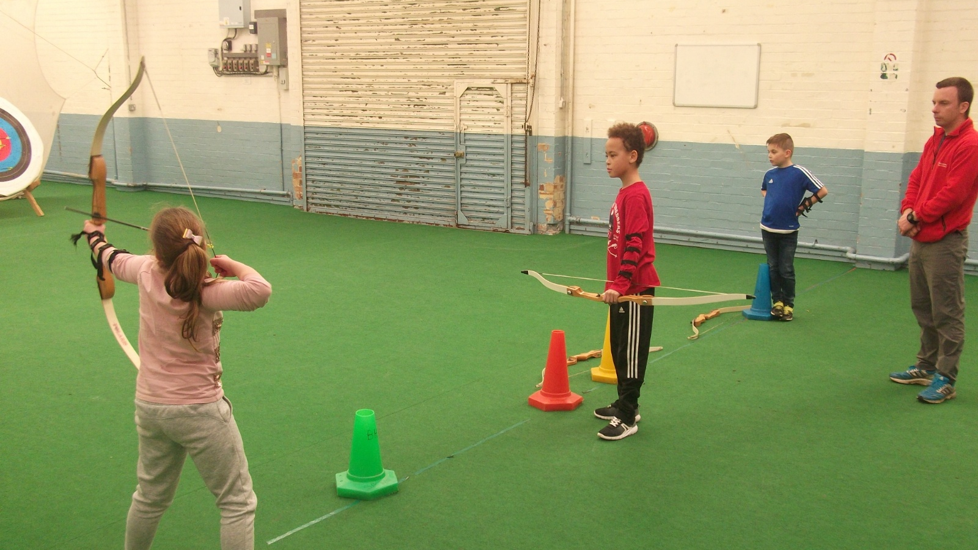
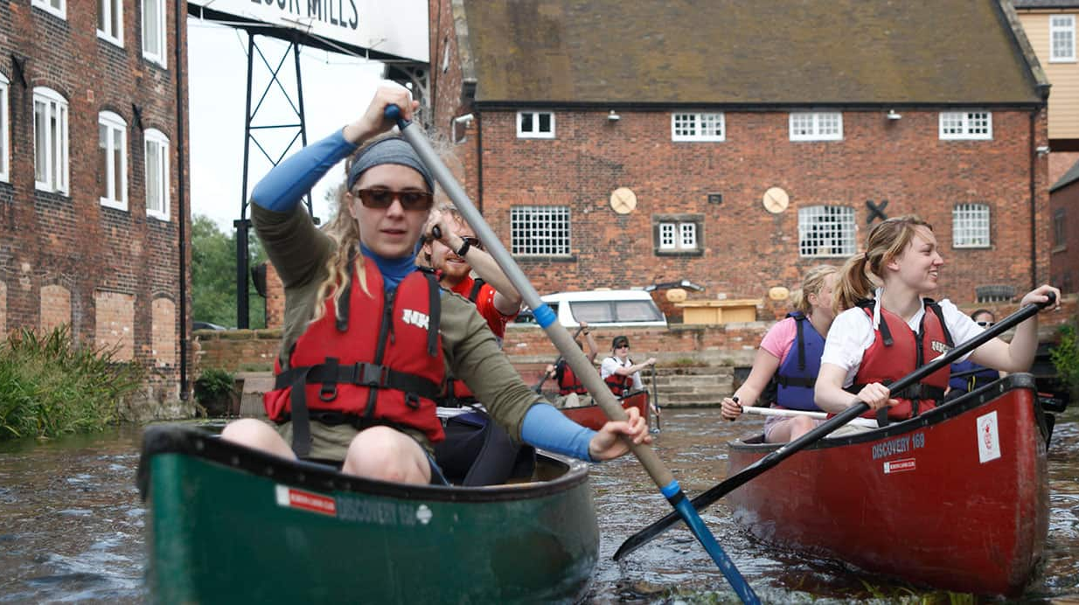
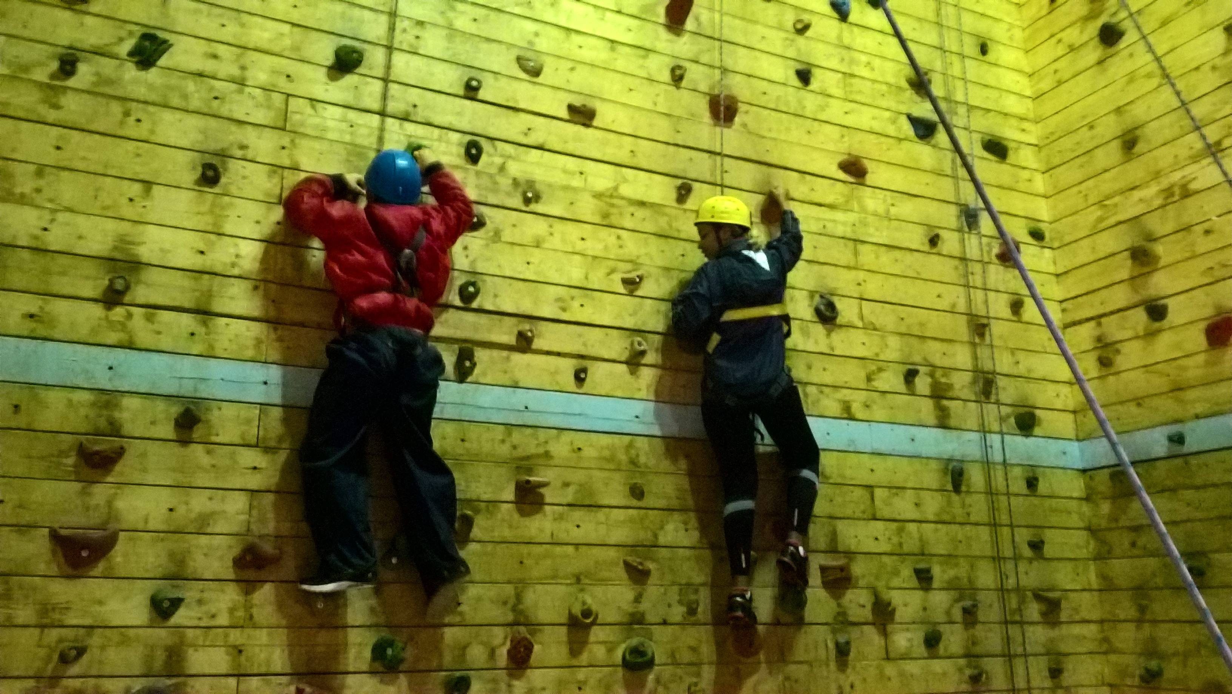
Everyone will do all of the activities but they will come at different times for different groups.
Notes:
Enjoy, try

Slide 11
Group activities
Monday morning - all together: orientation
Monday afternoon
1 Climbing
2 Canoeing
3 Archery
4 Climbing
5 Archery
6 Canoeing

Slide 12
Tuesday activities
Morning Afternoon
1 Archery 1 Survival
2 Survival 2 Archery
3 Canoeing 3 Climbing
4 Archery 4 Survival
5 Canoeing 5 Climbing
6 Survival 6 Archery

Slide 13
Wednesday activities
Morning
1 Canoeing
2 Climbing
3 Survival
4 Canoeing
5 Survival
6 Climbing
In the afternoon, we will have some time to visit the adventure play area and explore any other areas of the site that we may wish to. We leave at 14:45.

Slide 14
Day Pupils
Monday
Come to school on Monday with a day bag including a towel, change of clothes and a water bottle.
Get the bus with everyone else (and perhaps help carry a bag!).
Collection from cabins at Beaumanor at 20:00. If you need a code to get in at this time, we will ensure that you have it.
Tuesday
Arrive at cabins of Beaumanor by 09:15, having had breakfast at home, to join in with the activities. Have a day bag with a change of clothes, towel and water bottle.
Collection from Beaumanor Hall at 20:00.
Wednesday
Arrive at cabins of Beaumanor by 09:15, having had breakfast at home, to join in with the activities. Have a day bag with a change of clothes, towel and water bottle.
Return on bus to school with all pupils. Collection at 15:00.

Slide 15
Monday bag drop off
6Mo / 6Mc – IT Suite
5G – Outside Miss Winton’s office
3/4B / 2BP – J005
Put your bags down and then go to your classrooms. Please don’t block the doors.

Slide 16
Monday
08:30 Arrive at school with belongings
09:30 Begin journey to LSF bus park
10:00 Arrival at Beaumanor Hall and Orientation Activities
12:00 Lunch (provided by Beaumanor)
13:10 2 groups canoeing
13:30 2 groups archery, 2 groups climbing
16:00 Return and settle in cabins
17:30 Dinner
18:00 Murder Mystery
20:00 Free time
21:00 Supper (Dusk)
Notes:
All pupils will be informed which group they are in so that they can have the correct things ready. I would recommend those canoeing wear there canoeing clothes all day.

Slide 17
Tuesday
06:45 Rise for breakfast
07:30 Breakfast in the Main Hall
09:30 Archery / Climbing or Survival
12:00 Lunch
13:30 Survival / Climbing/ Archery
17:30 Evening Meal
18:00 Hide and Seek in the Cellars and Gym Games – two groups that will swap.
20:00 Free time
21:00 Supper (Dusk)

Slide 18
Wednesday
06:45 Rise for breakfast
07:30 Breakfast in the Main Hall
09:30 Canoeing / Survival or Climbing
12:00 Lunch
12:30 Free time
15:00 Arrive at LSF bus park
Notes:
15:00 – Realise it is earlier than normal, pupils will be tired so do encourage this to get home, rest, clean ad ready for school the next day. If someone else is going to pick up your child at this time – a grandparent please let us know. Equally, if you would like your child to go to WAC or on the bus, please let us know – class teacher

Slide 19
Other information
Bedtimes and sleep
We know and understand that a residential is an incredibly exciting experience. However, it is most enjoyable if we all get some sleep.
Early pick up
We are asking your families to pick you up a little earlier than usual. This is because they will have missed you and want to see you. It is also school the next day and you will be tired.
Notes:
Give more details about food
Reference in activities canoeing, can’t leave someone at the side as a loop.

Slide 20
Any questions?

